Slide 1

Department of Computer Science &Engineering
Artificial Intelligence & Machine Learning
A.P. Shah Institute of Technology
G.B.Road,Kasarvadavli, Thane(W), Mumbai-400615
UNIVERSITY OF MUMBAI
Academic Year 2023-2024

Slide 2
Flappy Bird
By
Varun Raut (22106106)
Pratik Redekar (22106029)
Sarang Sawant (22106080)
Pranet Pednekar (22106098)
Under the guidance of
Prof. Monali Korde

Slide 3
INDEX
Introduction
Role of HTML5
Use of CSS in development of the game
Major components of JAVASCRIPT code
Block diagram
In-game pictures (sample)
Algorithm
Conlusion
References

Slide 4
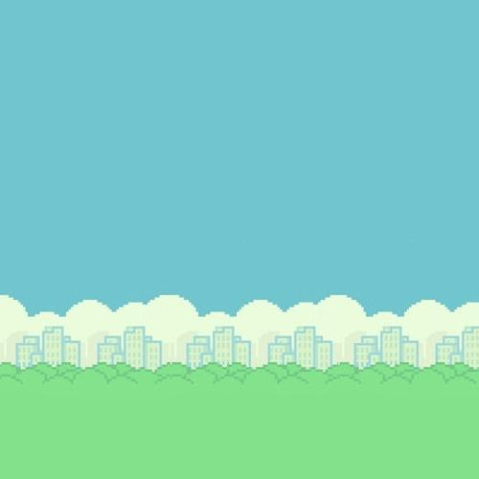

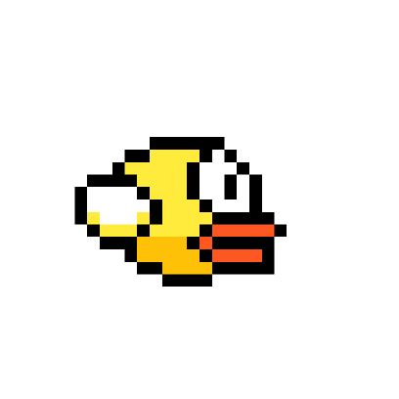
Flappy Bird
in the game flappy bird, tapping the screen causes the bird to fly. some people find this game difficult because you have to redo it if you hit a pipe because your bird will fall.

Slide 5

3 COMPONENTS OF THIS GAME:
Using css to design the game.
Using HTML5 canvas.
Using javascript to code the game.

Slide 6
ROLE OF HTML5 :
To create a website which allows cross platform and browser users to play the game.
HTML structure sets up the basic framework for the flappy bird game webpage. The CSS file "flappybird.css" will handle the styling, and the javascript file "flappybird.js" will handle the game logic, with the main game area being a canvas element with the ID "board".

Slide 7
USE OF CSS IN DEVELOPMENT OF THE GAME:
Using css we will:
Be importing various images that are to be included in the game. For example: pipes(top and bottom), bird, etc.
Be setting the background colour as light blue to resemble the sky.
Also be using it to style the text which will be displayed to the end user.

Slide 8
MAJOR COMPONENTS OF JAVASCRIPT CODE :
Board and canvas setup.
Game physics.
Game loop.
User input.

Slide 9

IMAGE PREPARATION : BIRD :
A bird acts like in real world that its jump and fall will be affected by gravity. When we implement the object motion formula in our code, time calculation is an issue because we use a counter counting instead of the system clock. We put the delay in our loop and try a suitable count number for our time unit. In addition, we add a status variable to indicate if the bird's status is rising or falling. It cooperates with our jumping and falling functions with an iteration loop that supports continuous jumping without multi-threading.

Slide 10

PIPES :
This submodule keeps updating the X coordinates of the pipes that have already appeared on the screen (by decrementing them in every cycle), as well as the length of the upcoming pipe that is going to appear from the right side of the screen. The length of the pipes should be random, as long as the pipes are constant. Once the pipe moves out of the screen, we reset the coordinate so that it can reappear from the right side of the screen.

Slide 11
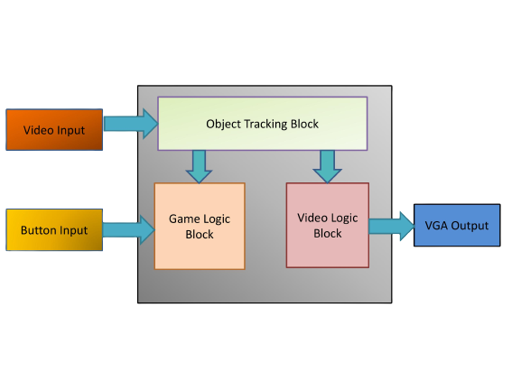
BLOCK DIAGRAM :

Slide 12
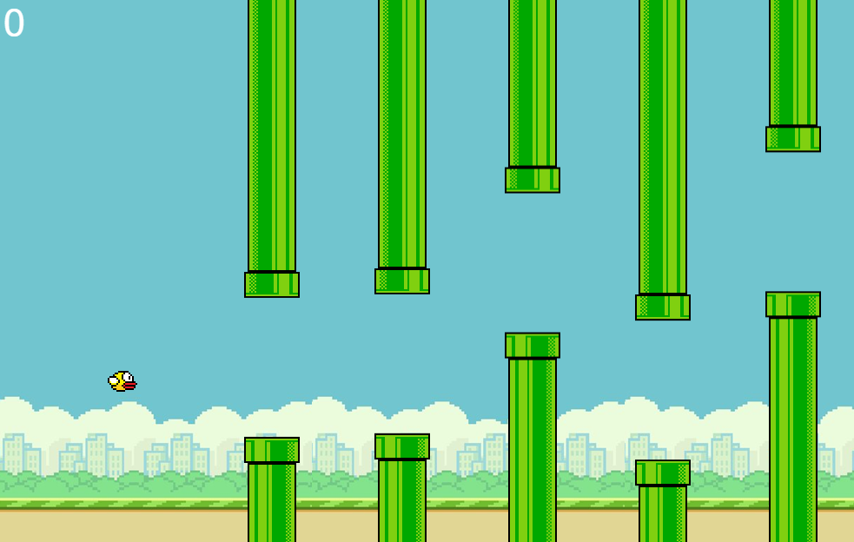
IN - GAME PICTURES :
The final result will have minor differences*

Slide 13
ALGORITHM:
Step 1: Start.
Step 2: Load bird and pipe images. Set up the window.onload function to start the game after the page loads.
Step 3: Implement the game update loop using requestAnimationFrame. Check if the game is over; if so, set gameOver to true.
Step 4: Calculate the bird's new position based on velocityY (vertical speed) and gravity.
Step 5: Move each pipe to the left by velocityX. Draw the pipes on the canvas. Update the score when the bird passes a pipe. Check for collisions between the bird and pipes.

Slide 14
ALGORITHM(continued):
Step 6: Remove pipes from the pipeArray that have moved off the left side of the canvas.
Step 7: Generate random Y-coordinates for the pipes within specified bounds. Create top and bottom pipes with their respective images and positions.
Step 8: Check if the player pressed the spacebar or "ArrowUp" key. Make the bird jump by setting a negative vertical velocity (velocityY). Step 9: Check If the bird has collided with the pipes using detectCollision function or if the bird has moved out of the screen then set gameOver to true else go to Step 3.
Step 10: End.

Slide 15
CONCLUSION:
The main game components, such as bird movement, gravity, pipe production, collision detection, and scoring, will all be done effectively. These rules closely resemble the dynamics of the first Flappy Bird game. We added visuals and resources for the bird and pipes, boosting the game's aesthetic appeal. Asset loading and rendering were handled efficiently to minimize load times. We added visuals and resources for the bird and pipes, boosting the game's appearance. Asset loading and rendering were handled efficiently to minimize load times.

Slide 16
REFERENCES:
[1] Sung K, Pavleas J, Arnez F, Pace J. Introducing 2D Game Engine Development with JavaScript. Build Your Own 2D Game Engine and Create Great Web Games: Using HTML5, JavaScript, and WebGL. 2015:1-3.
[2] Bunyan, Karl. Build an HTML5 Game: A Developer's Guide with CSS and JavaScript. No Starch Press, 2015.
[3] Burchard, Evan. The Web Game Developer's Cookbook: Using JavaScript and HTML5 to Develop Games. Addison-Wesley, 2013.

